Slide 1
Ensemble Classifiers
A Flexible
Bagging Ensemble Classifier
(Applied To The Click-Through Problem)
Nelson R. Manohar

Slide 2
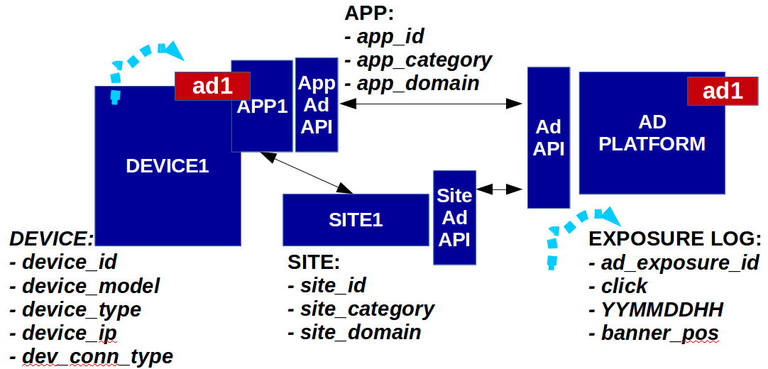
Application (Click Through Rate)
ML
ClickProbs
GIVEN:
Log of millions of ad impressions (presented to mobile users by this AdPlatform) along with a bit indicating whether each impression resulted in Click or NoClick
FEATURES (how each ad impression was exposed to the user):
anonymous numerical features and factors accounting for site visited, app used, type of device and connectivity, hour, etc.
PREDICT:
the Click Probability (ClickProb) of ad impression for test samples

Slide 3
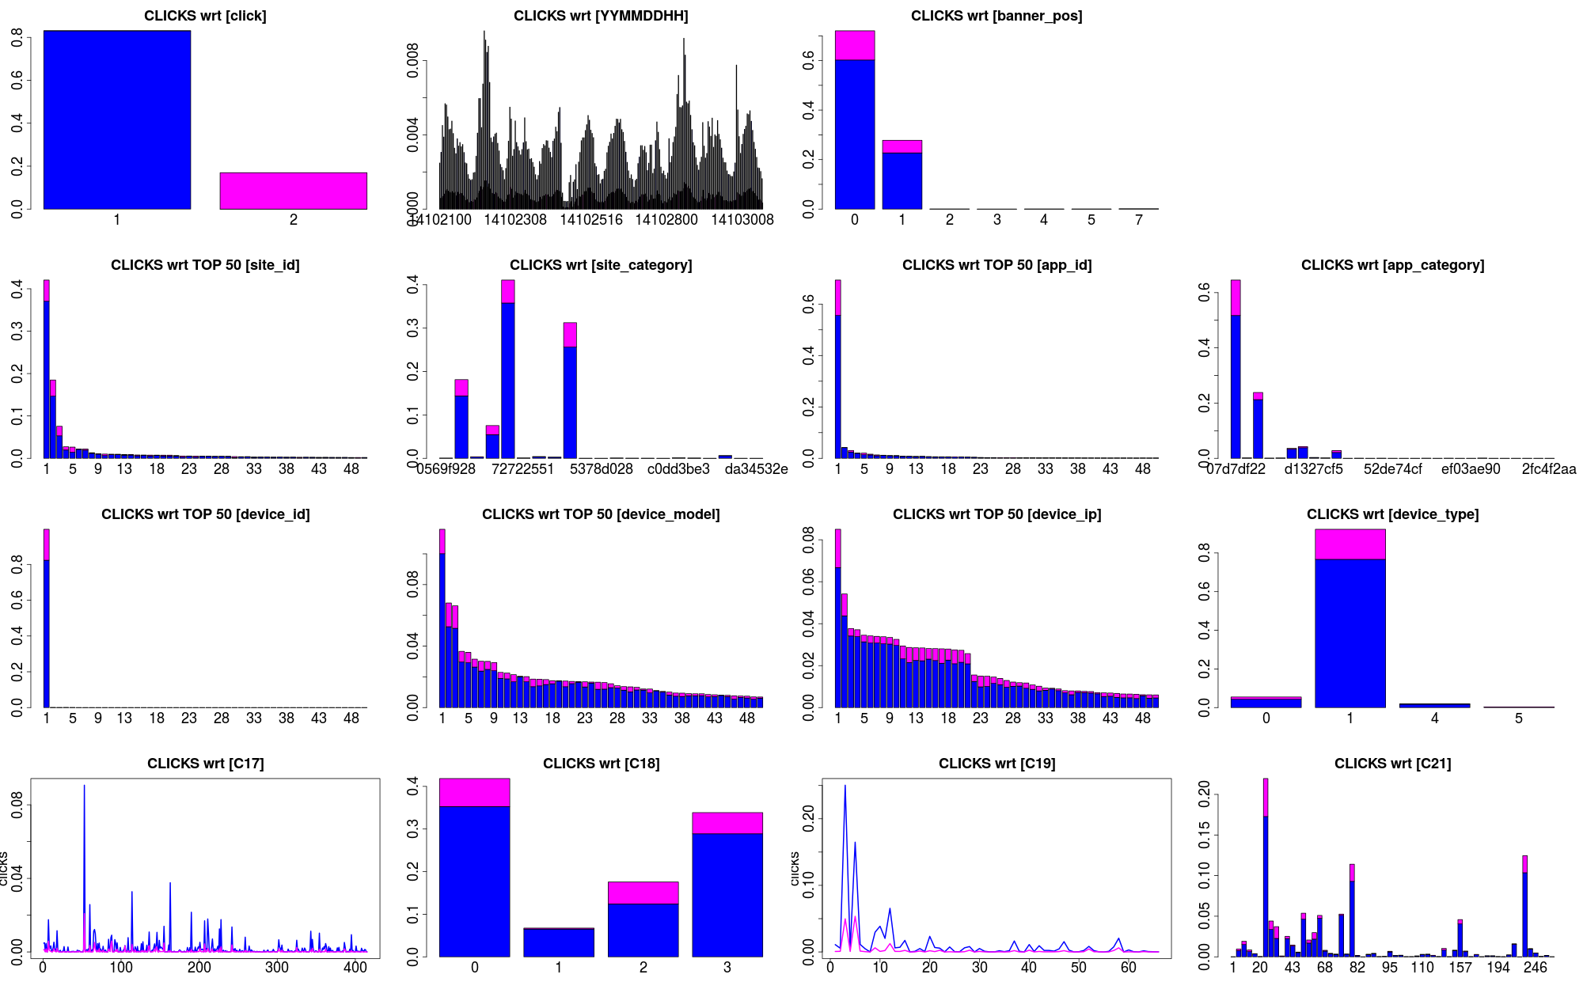
Quick Look at the Features
F
F
2 out of 6 banner pos
4:1
anomalous
anomalous
Class 0

Slide 4
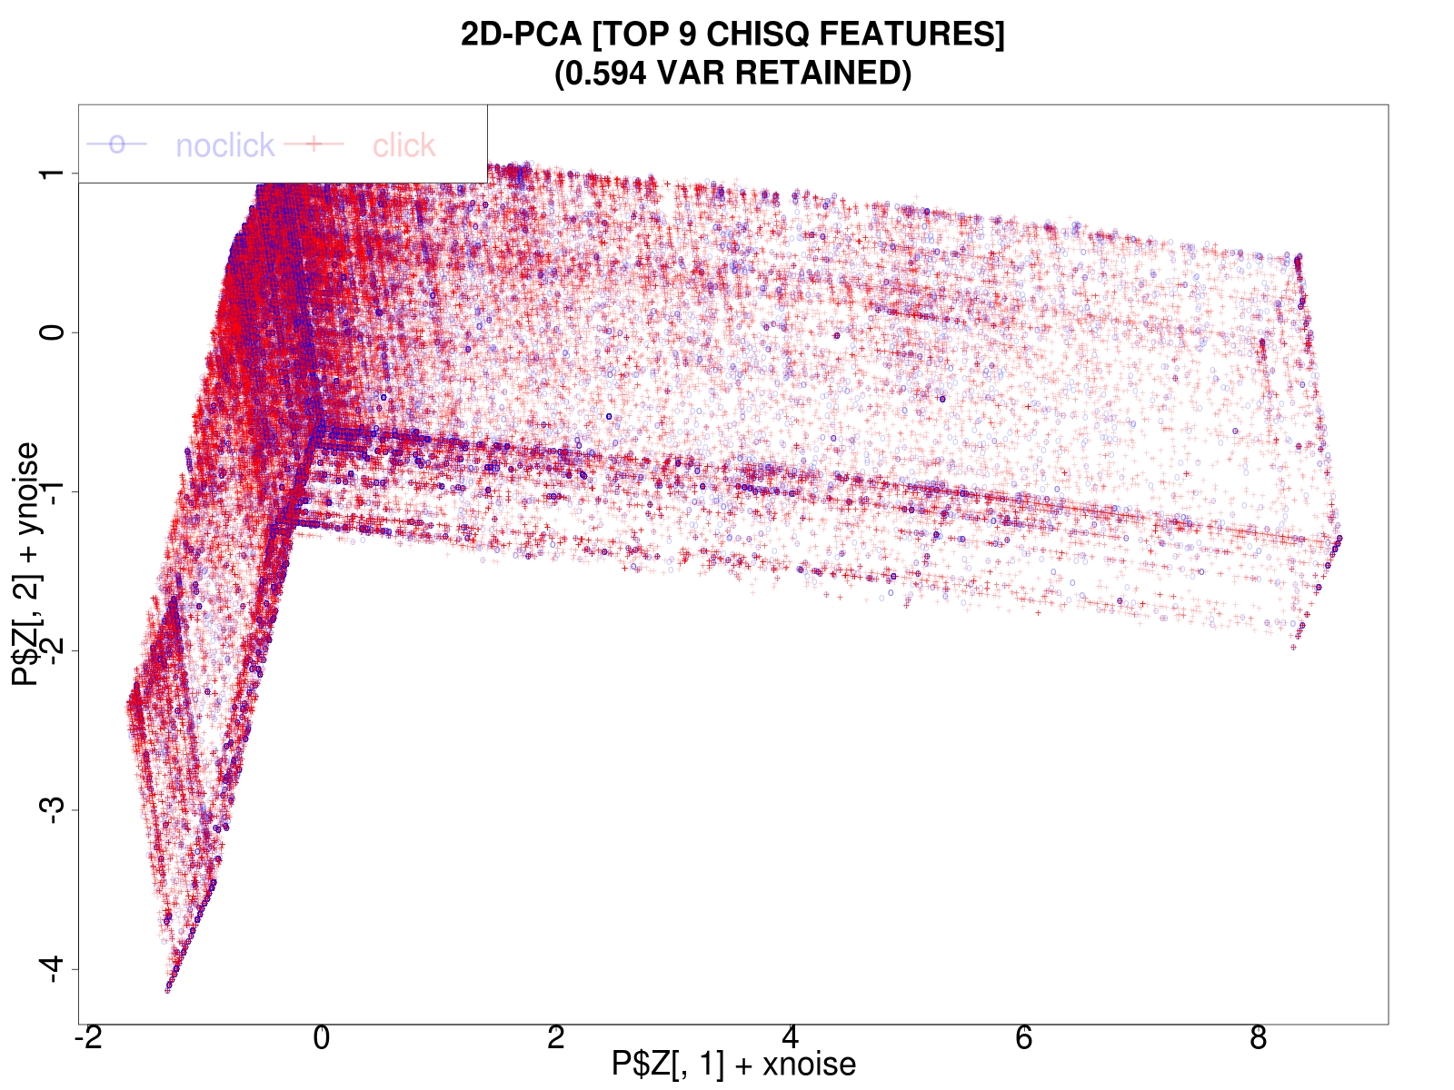
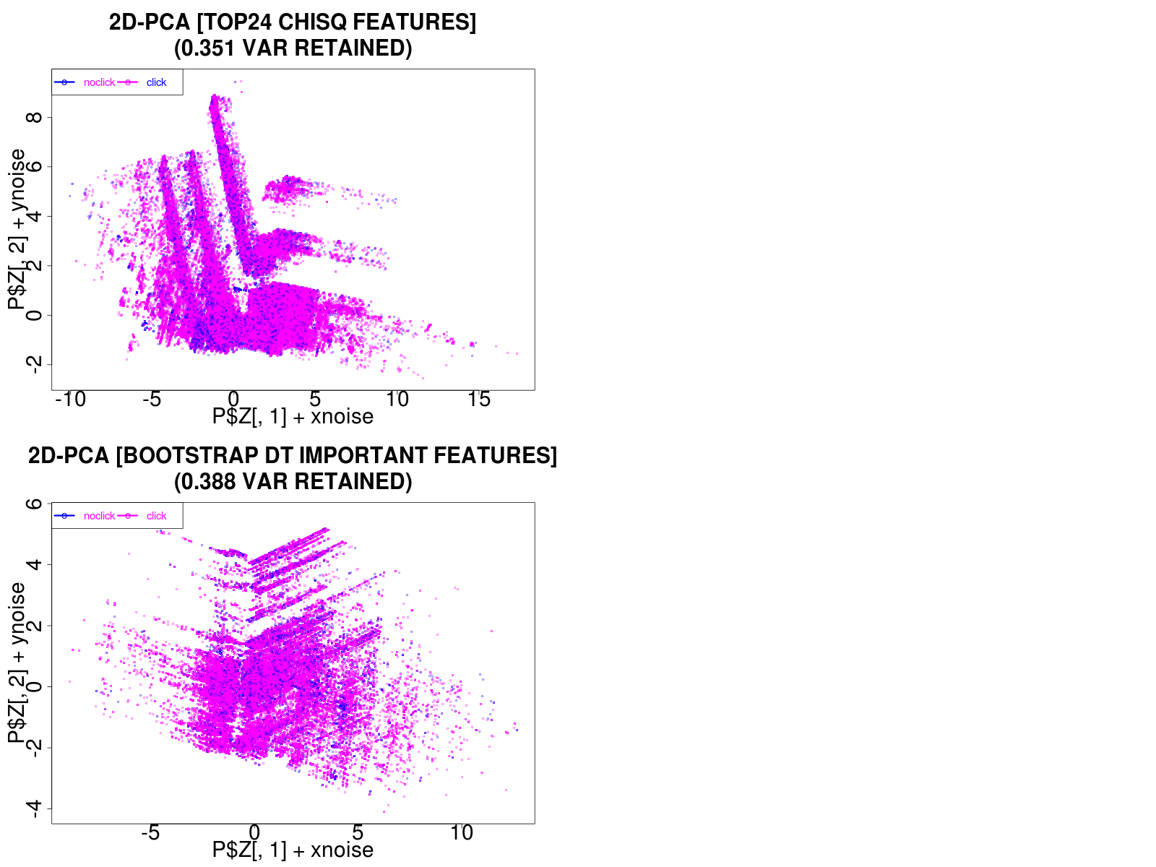
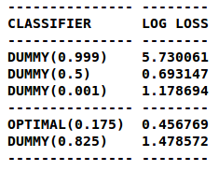
Underlying Problem
With respect to given features:
Domain knowledge missing (features are anonymous and no details given)
Clicks samples are quite similar to NoClicks samples
Predictive Baseline:
How well do Dummy Classifiers do with this data?

Slide 5
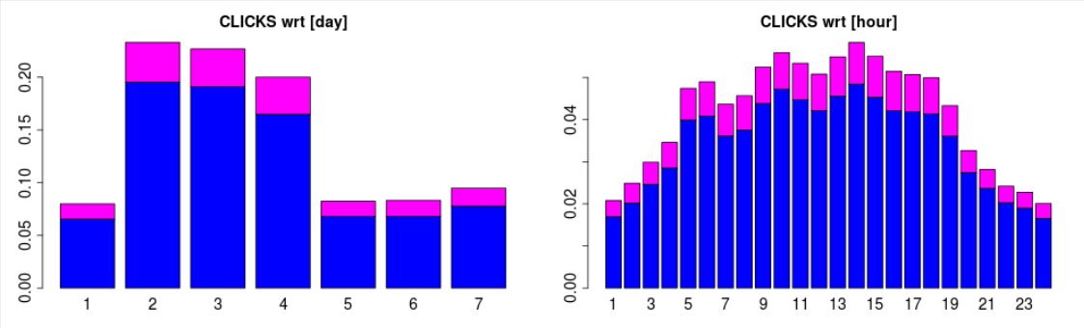
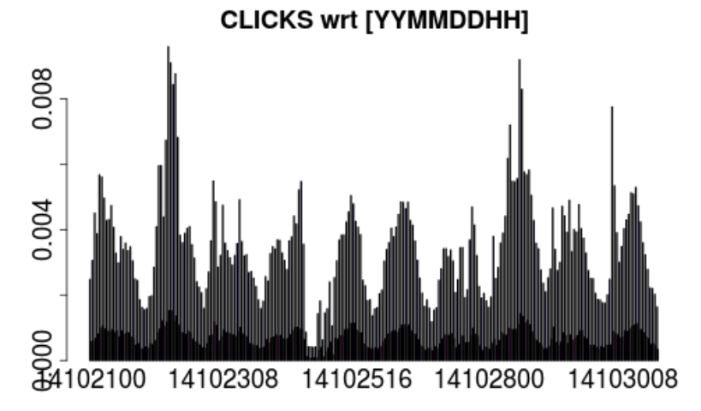
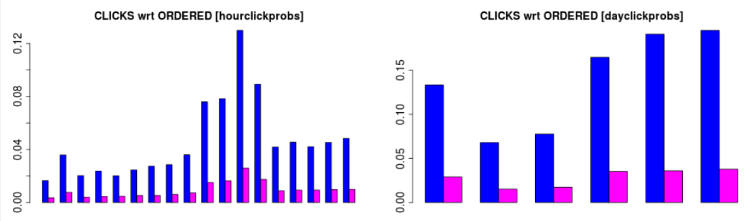
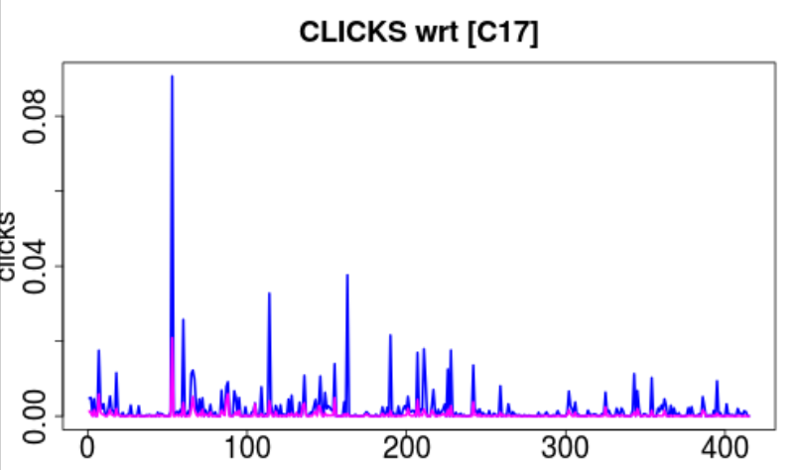
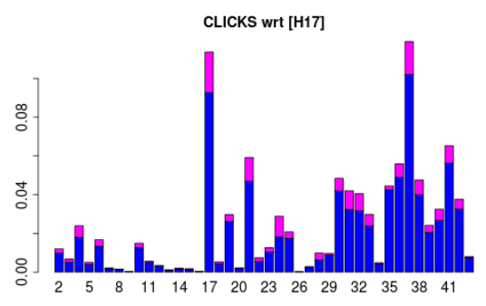
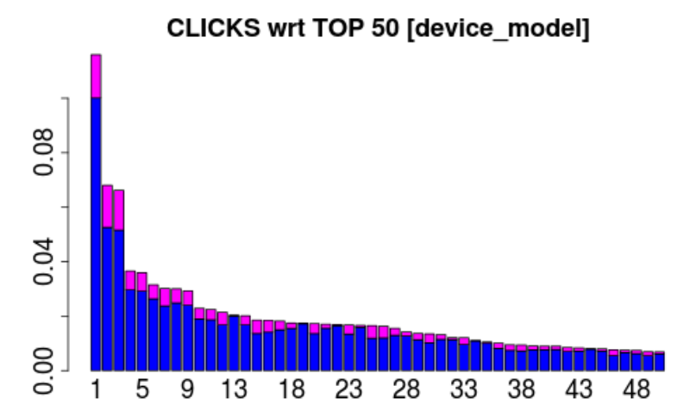
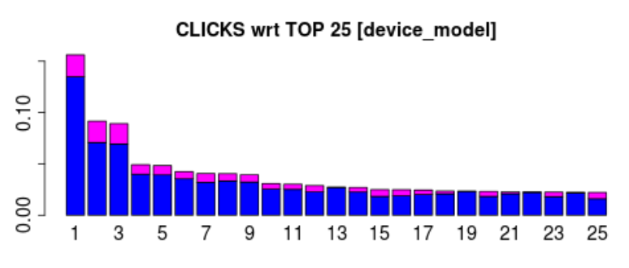
Basic Feature Generation
Temporal
Day, Hour
Probabilities
P(Click|Factor_Level)
Interval Cuts:
Num. Factor Levels
Top N

Slide 6
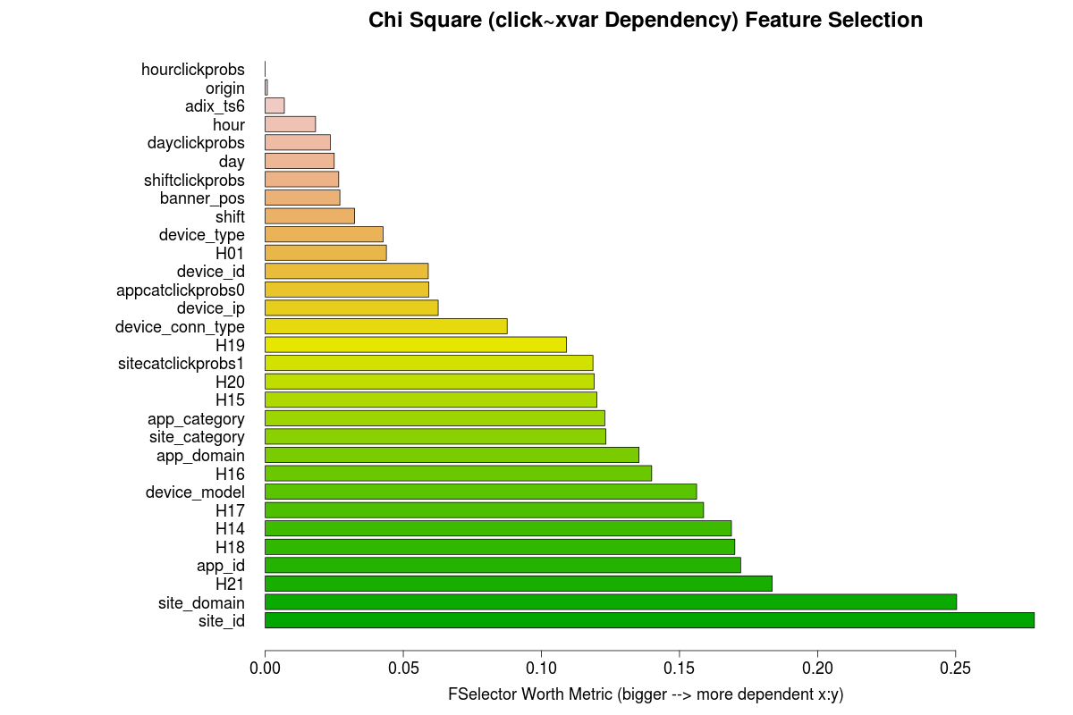
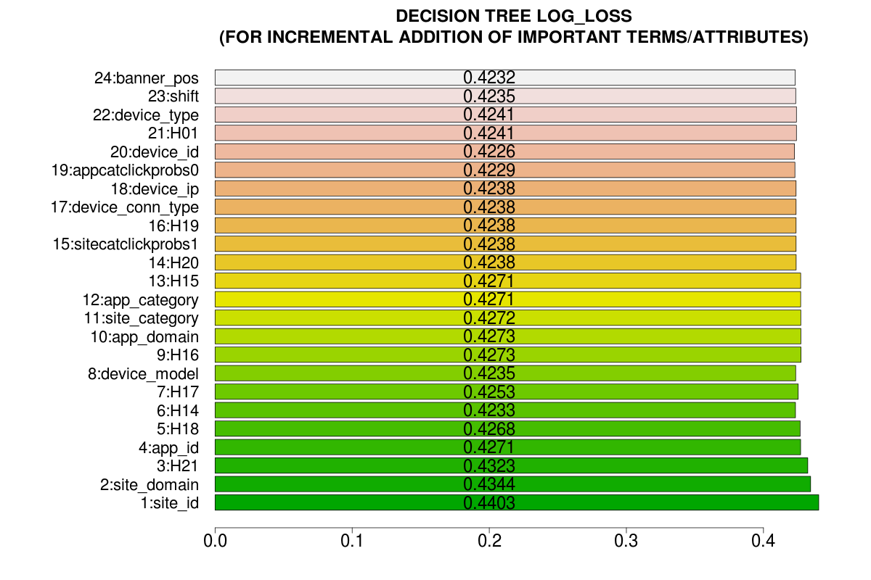
Feature Selection
M5
M4
M3
M2
M1

Slide 7
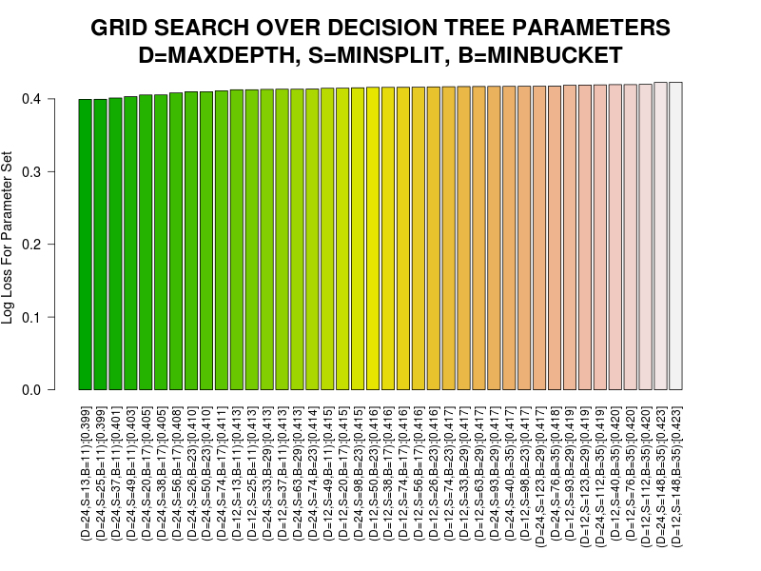
Grid Parameter Search (using Baseline Classifier)
Problem is affine to Decision Trees
Parameters for DT/RF:
D=Max Depth
S=Min Split
B=Min Bucket
Region on
D=24,S=20-50,B=11-17

Slide 8
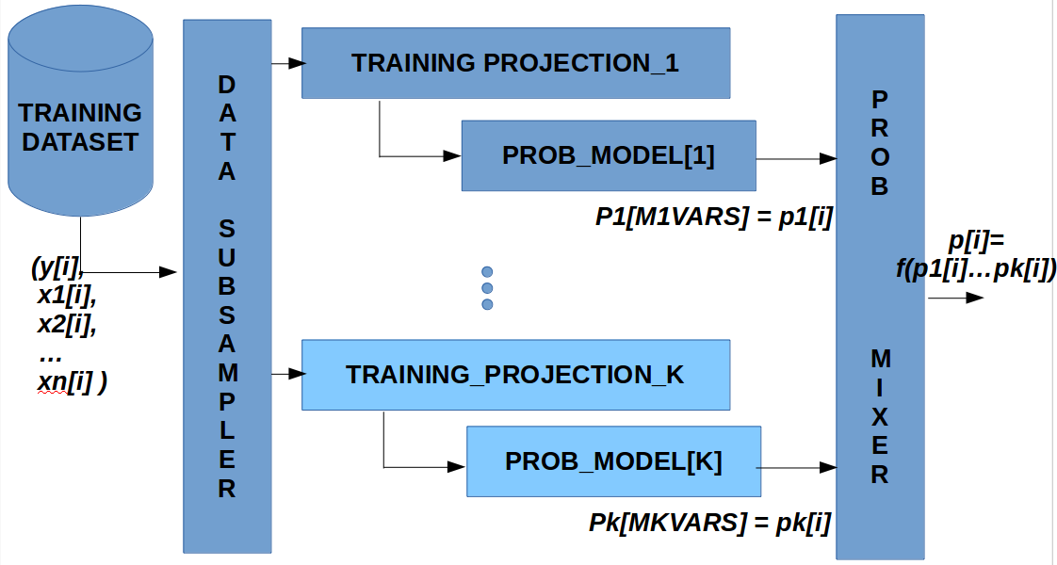
Ensemble Modeling (Bagging Framework): ClickProbs = DT( click ~ X[S, xvars] )
GENERATE some candidate models:
M1 = DT( FSELECT_VARS[1:3]
M2 = DT( FSELECT_VARS[1:6]
M3 = DT( FSELECT_VARS[1:9]
M4 = DT( FSELECT_VARS[1:12]
M5 = DT( FSELECT_VARS[1:15]
(Up to) 9 models are specified; models can be replicated
Prob. Mixer computes a weighted average of model's outputs
Each model learns with different dataset slice S of size N
Models can have different DT parameters (e.g, MaxDepth)
For these slides, all models have same DT parameters

Slide 9
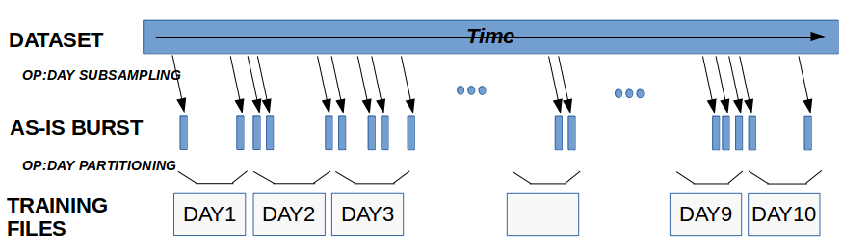
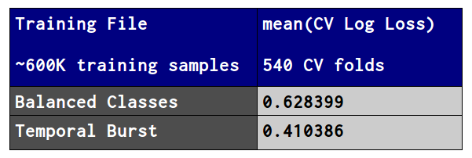
Subsampling Impact
Dataset has both:
Class 1/0 imbalance
Temporal patterns
Two Sub-sampling Choices:
Balance Class 1/0
Temporal Burst
Class 1/0 balanced sub-sampling increases LogLoss

Slide 10
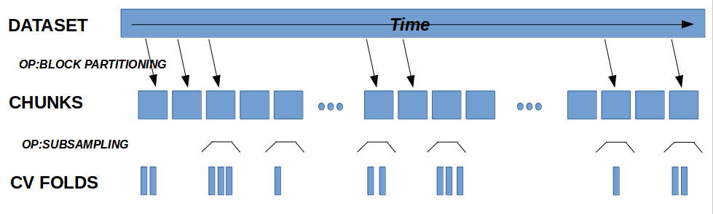
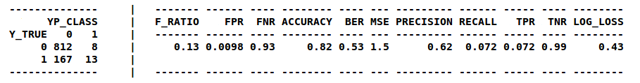
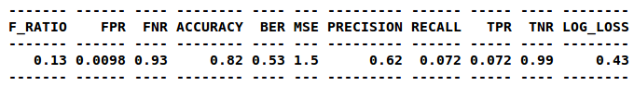
Cross-Validation (CV) Strategy
Dataset partitioned into chunks of 100K samples
Each chunk sampled with 3 random bursts of 1K samples
Each temporally cohesive sample represented a CV slice
Log Loss computed for each CV fold; then average reported

Slide 11
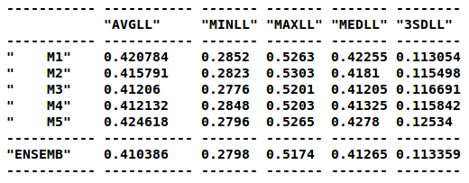
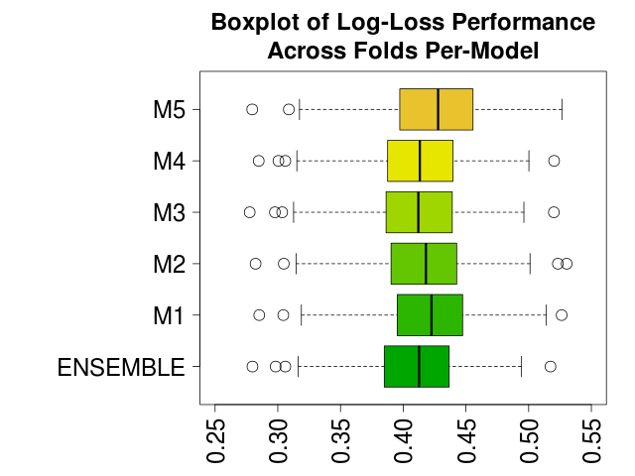
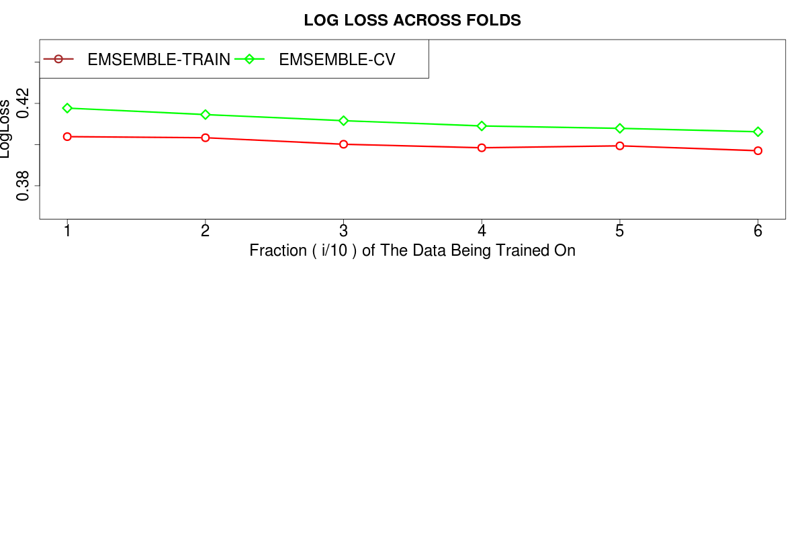
Ensemble-1: Cross Validation
First, using 540 CV folds,
Apply models to fold
Obtain each model output's click probabilities
Compute ensemble's click probabilities from those
Compute Log-Loss values for all models
Then, to compare candidate models, examine range of Log Loss of the models
Then, assess the ensemble's Learning Curve operating region

Slide 12
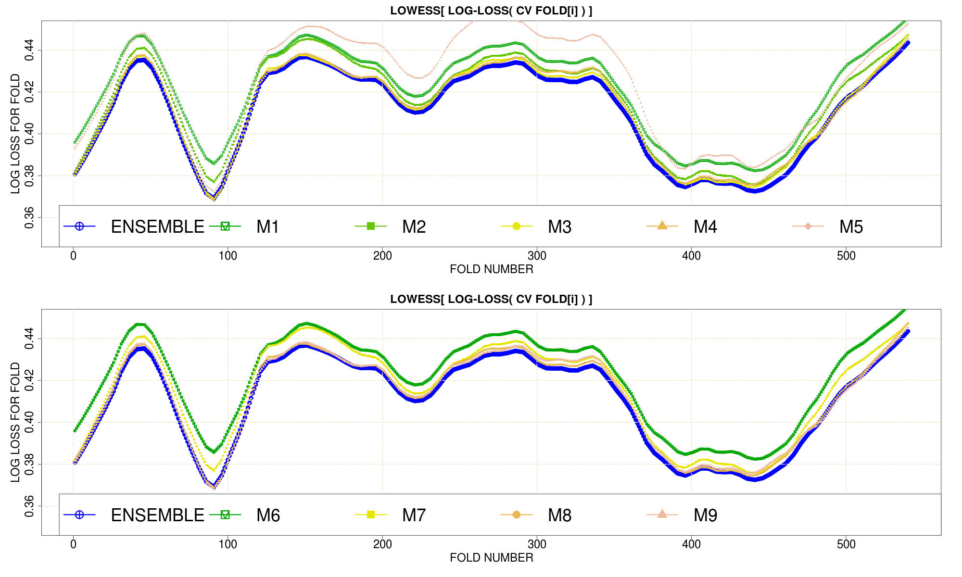
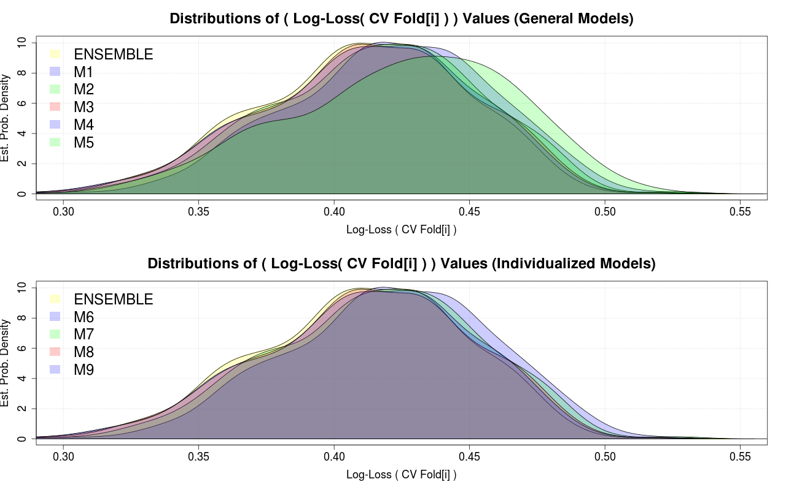
Ensemble Log Loss & Click Probabilities
lowess(logloss, f=1/10)
Est. Density (logloss)

Slide 13
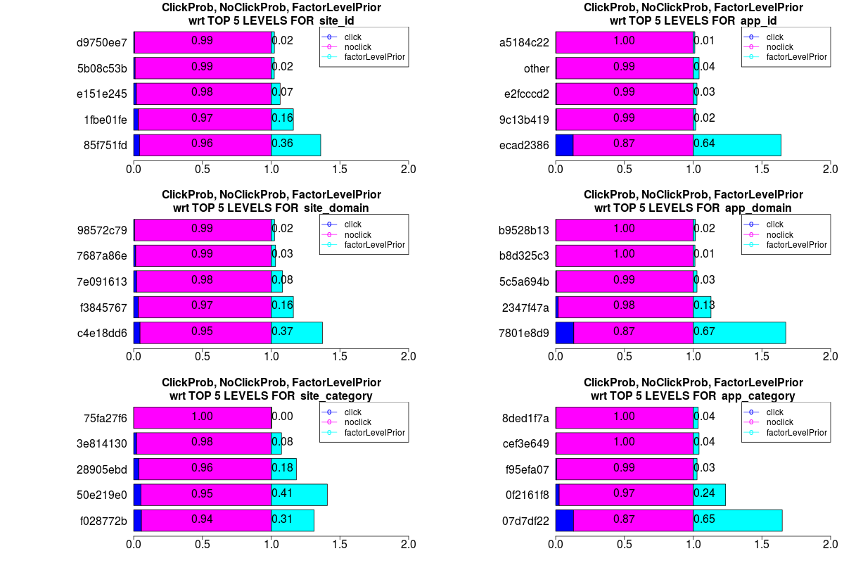
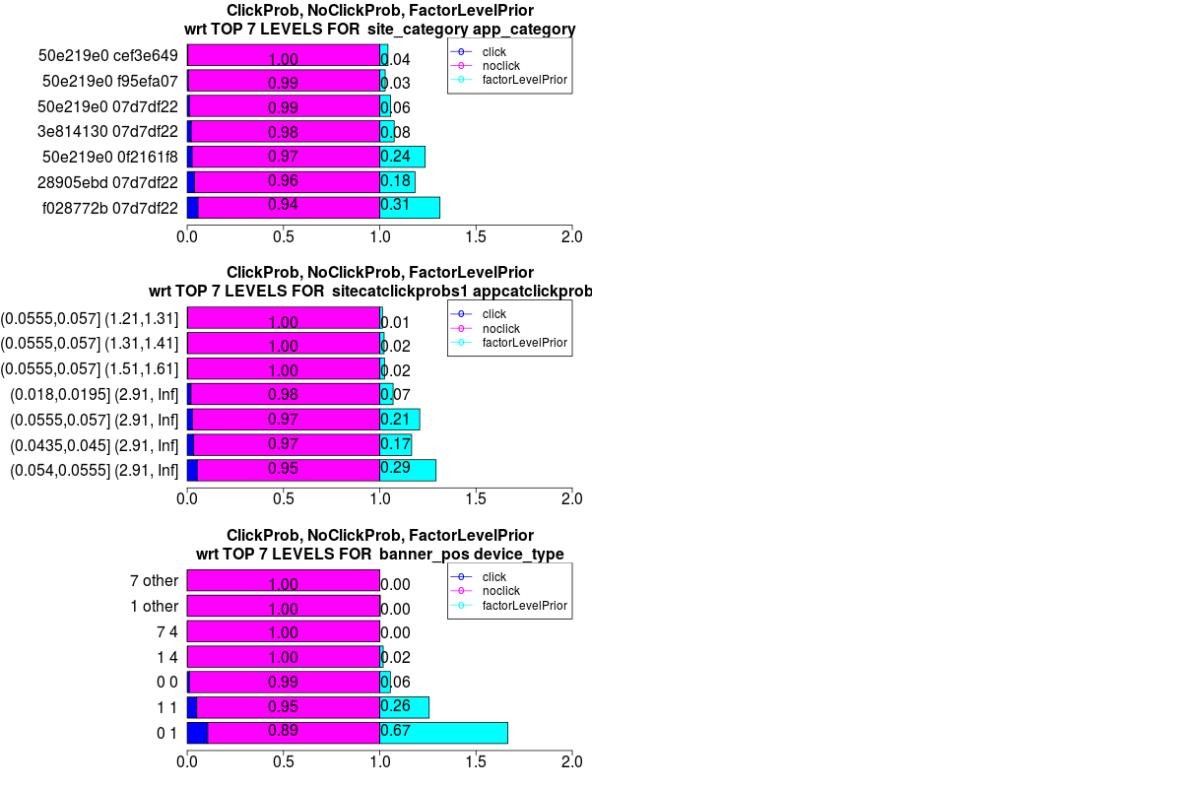
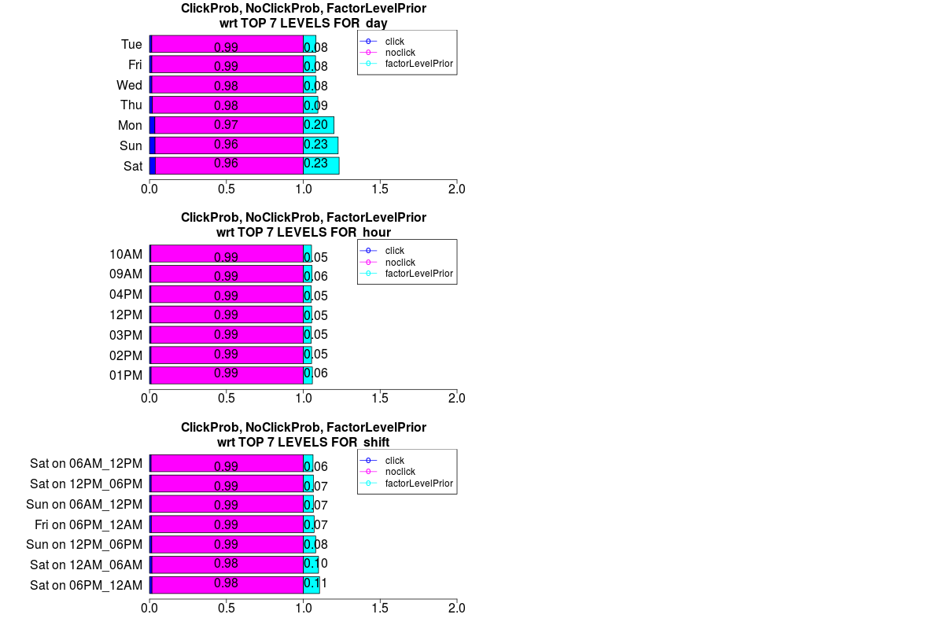
Observations: Factor Levels & ClickProbs
Explore/Exploit Customized Modeling to:
Automatically exploit narrowly targeted classifiers to boost performance
by specifying a targeting hypothesis of the problem-domain, e.g.,
Which sites are click more likely?
Are there combinations of device type & ad placement for which clicks are more likely?
Are there times of the week at which clicks are more likely?
Not boosting (i.e, not iterative, weight refinement yet)

Slide 14
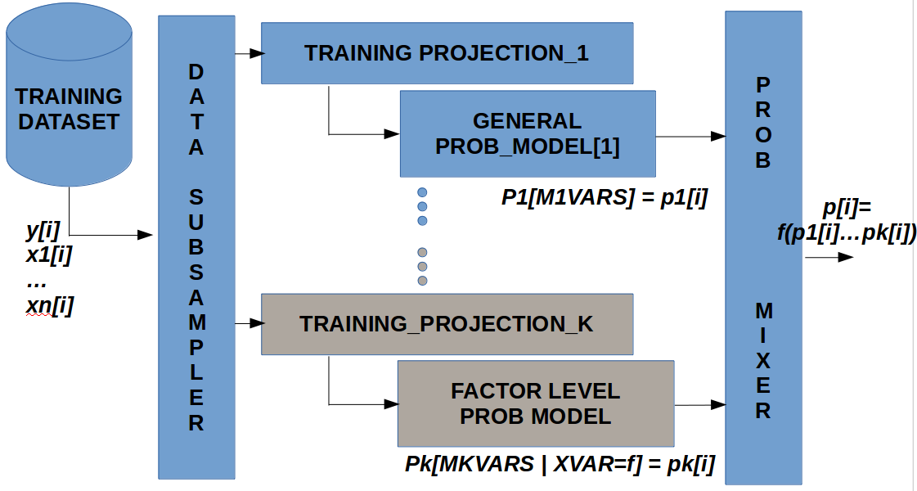
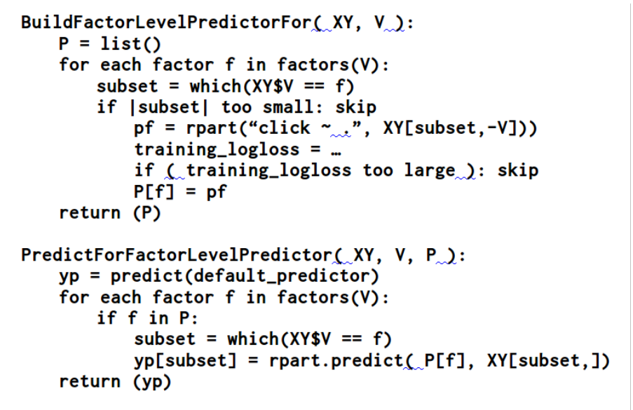
Adding Customized (Per Factor-Level) Models
Train a predictive model for each factor-level model F=flevel
DT(click~ X[ DatasetSlice[F=flevel,], ])
Customized Training, only with samples in slice assoc. with factor level flevel.
Customized Feature Selection done for each factor-level model F=flevel.
Selects only models with logloss performance above a threshold.
During prediction, predict if matching model exist, else, output default probs.
Number of models does not fit in memory so stored on disk; later on DB (for MR).

Slide 15
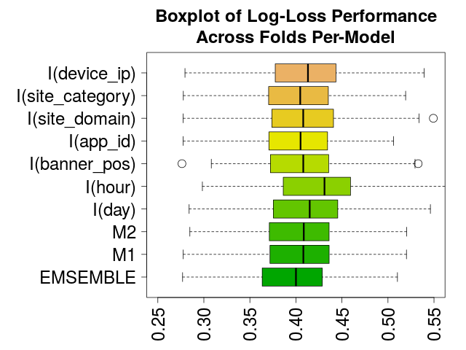
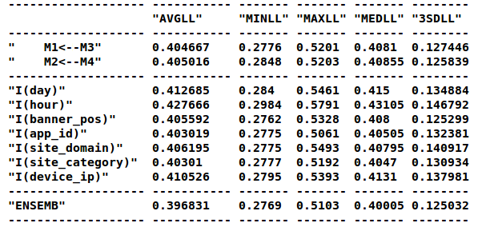
… Applied to App, Sites, Devices Hypothesis
Exploits predictive power of individual factor levels (e.g., F = site_id, fl = mail.yahoo.com)
Facilitates comparative evaluation of the predictive effect against baseline (e.g., paired t-test between CV LogLoss value populations of Hour vs. M1)
Facilitates exploring domain hypotheses (site_id, hour, banner_pos)
Can be extended into parallelization as well as boosting

Slide 16
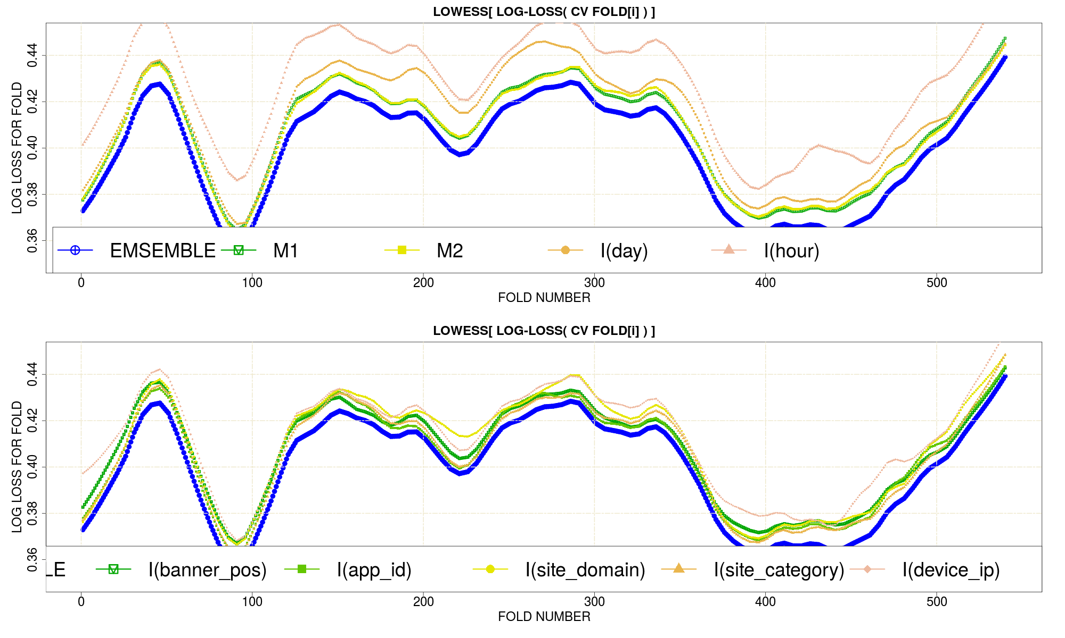
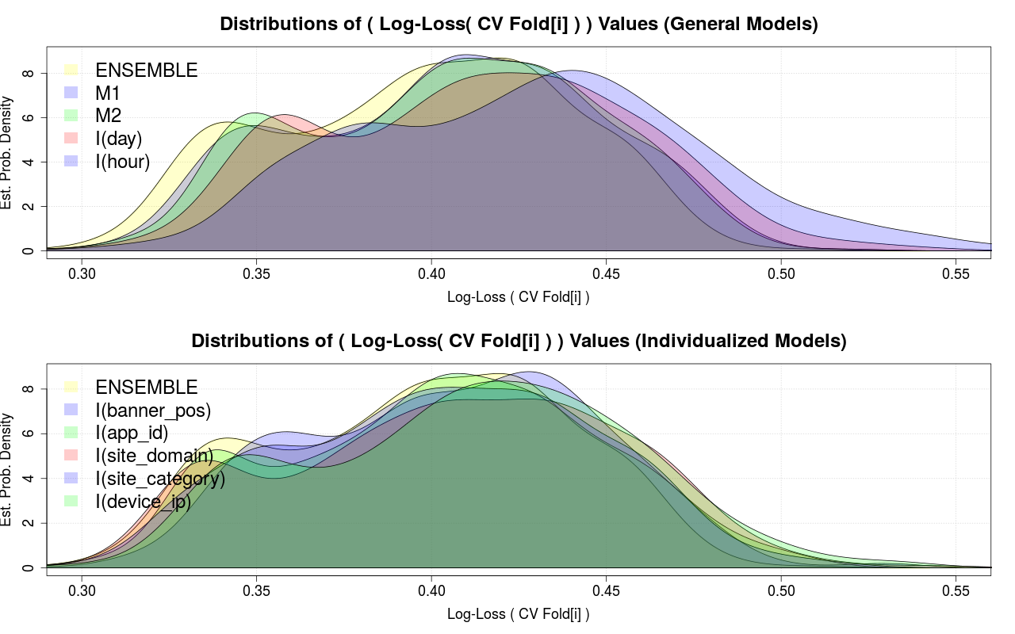
CV Log Loss Values For Custom Models
lowess(logloss, f=1/10)
density (logloss)

Slide 17
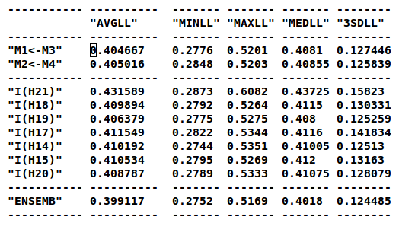
Ensemble Performance Trajectory
Training done with 0.5% of the data
Yet by trading 10x compute time for 1/100 training size, we reduced Log Loss to Kaggle levels.
Yet all 10x compute tasks are coarse-grain.
Very amenable to MR.

Slide 18
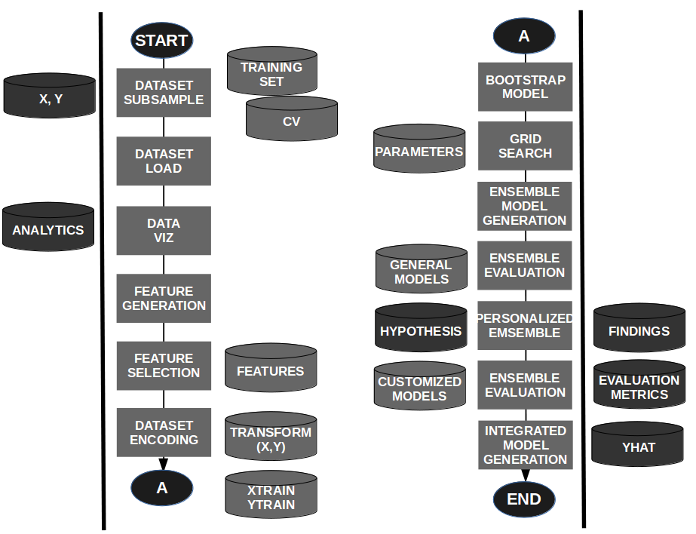
Data Pipeline
A flexible ensemble classifier pipeline in R:
For exploration of Factor/DT oriented ensemble modeling
Reusable and modular prototyping code base in R.
Ensembles positioned to be parallelized
Code at bitbucket.org/ nelsonmanohar / machinelearning

Slide 19
Concluding Remarks
Future Work:
Moving models and factor-level models into network DB
MR'd execution & throttling of model building/execution
Visualization & meta-analysis of exploratory modeling results over time
Autonomous feature exploration and generation of conditional probability features, clustering (e.g, social network features)
Boosting of factor-level models and/or ensembles
Integration of heterogeneous classifiers for special cases
Python, SQL, MR, Spark, More Datasets to Examine

Slide 20
Appendix Section
End of Presentation

Slide 21
Misc Slides: Background
Software Systems
Telephony and Intelligent (1-800) Networks
Multimedia Groupware (Asynchronous Collaboration)
Scalable Cloud Systems for Media (IP)
Measurements (Stationary Detection)
Data Mining and Machine Learning
DNA alignment prototyping
Retraining Post Doc in Social Network Analysis of Newsgroups
Malware Detection system (Windows and Android)
Education
Ph.D Computer Science & Engineering (1997)

Slide 22
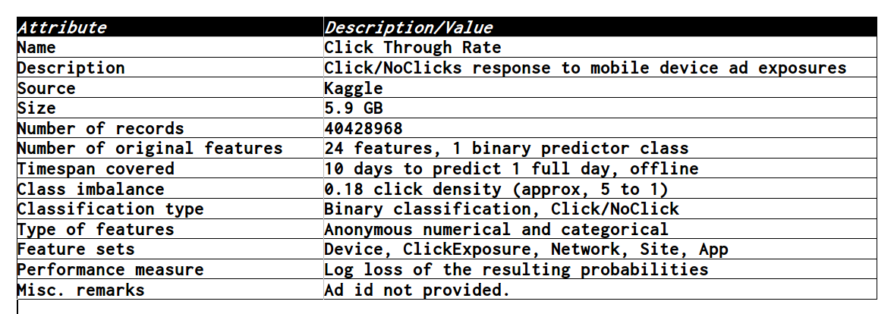
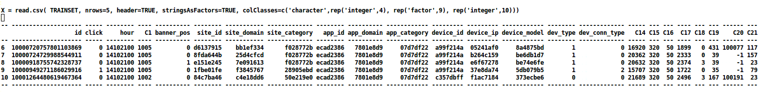
Dataset Details & Illustrative Samples
Some details of the Dataset
A look at the raw data...

Slide 23
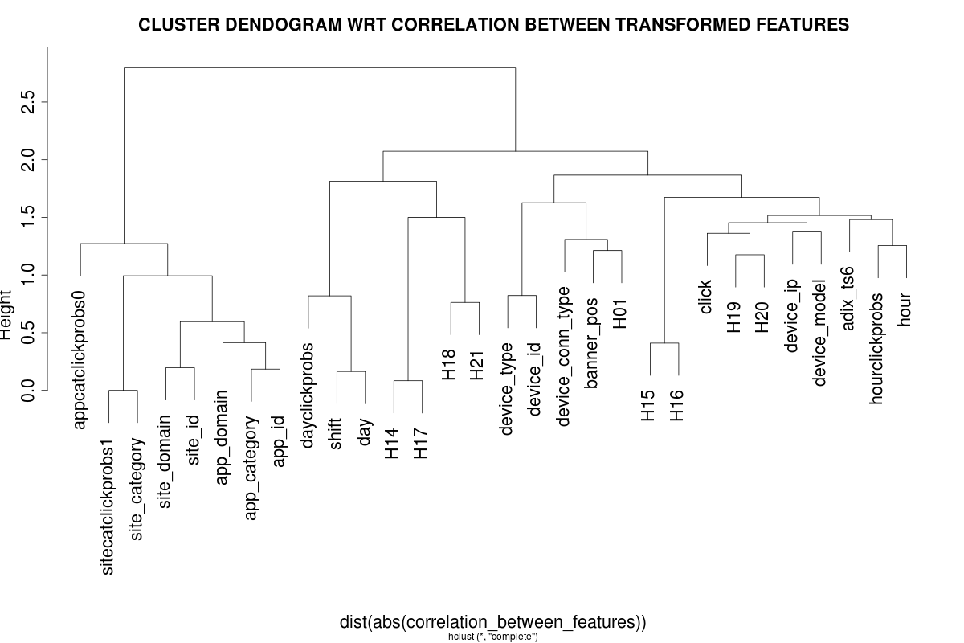
Miscellaneous Appendix Slides: Correlation Between Features

Slide 24
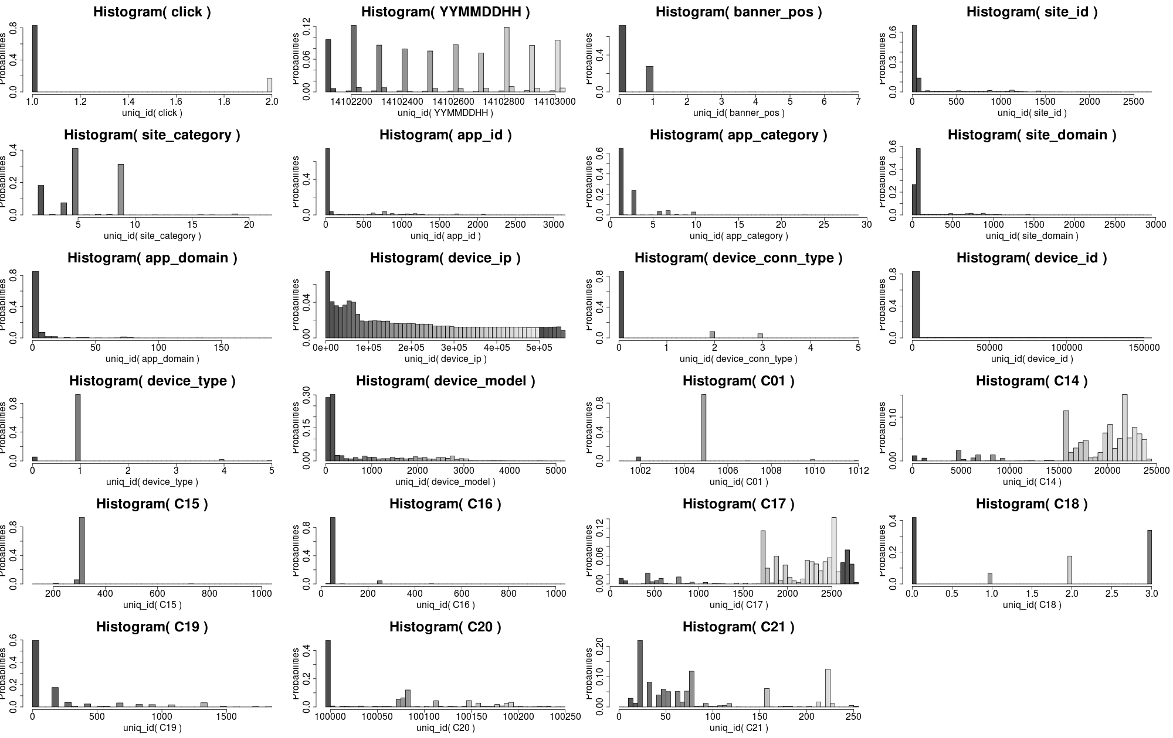
Misc. Slides: Dataset Details (1% subsample)

Slide 25
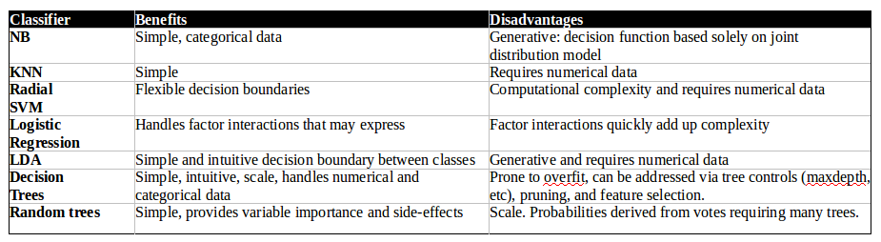
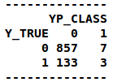
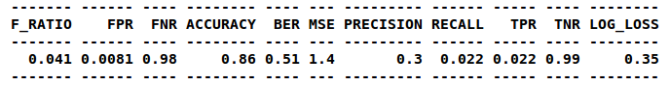
Baseline Classifier & Performance
Problem affine to ensemble of DT to address over-fitting
Log Loss metric is intuitively different to F-ratio

Slide 26
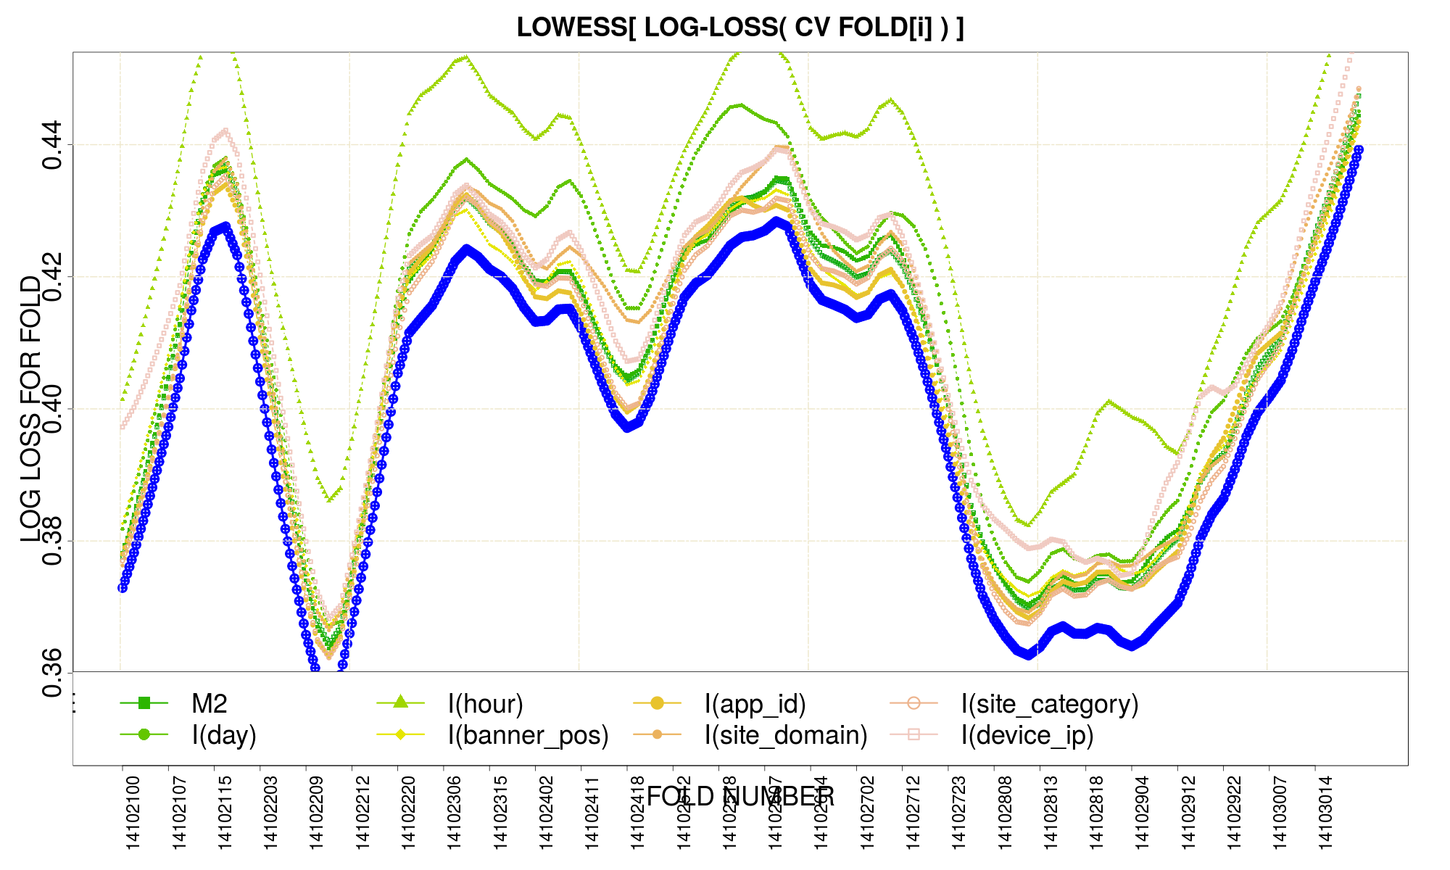
Miscellaneous Appendix Slides Time Span of the CV Folds[1:540]

Slide 27
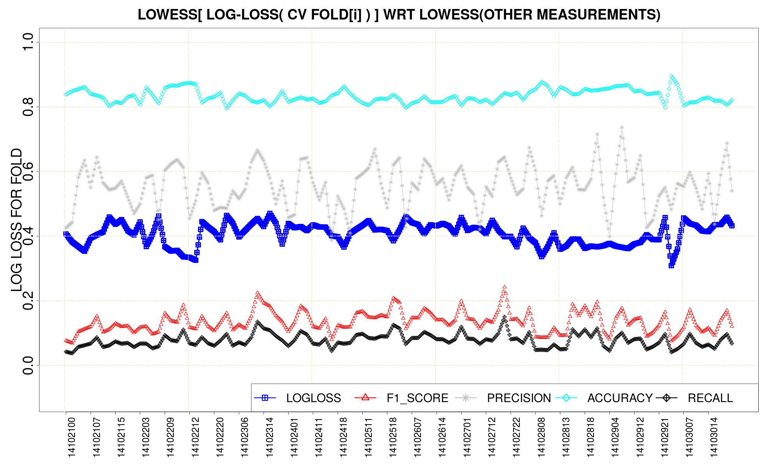
CV Log Loss vs. Other Metrics (lowess(x, f=1/100))

Slide 28
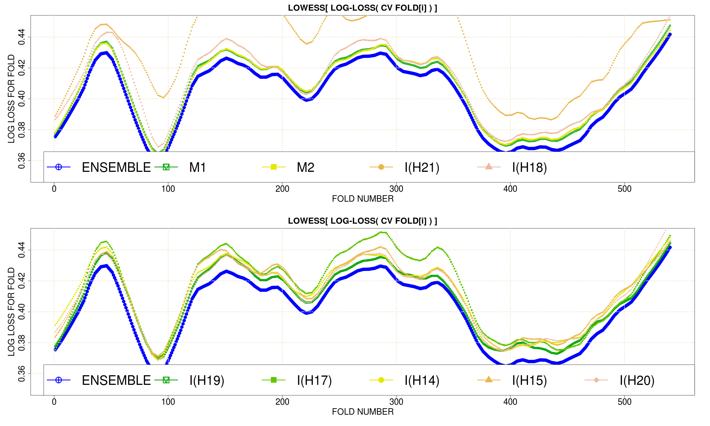
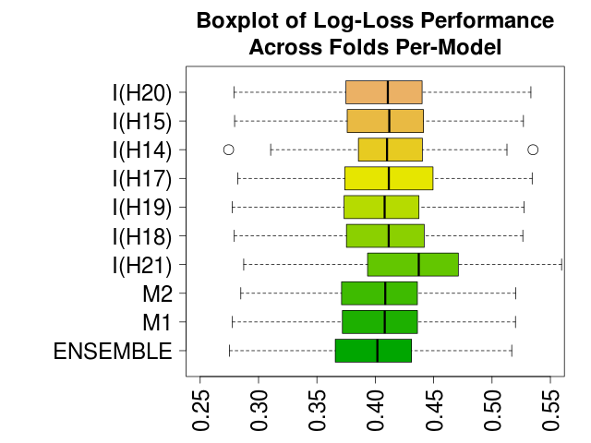
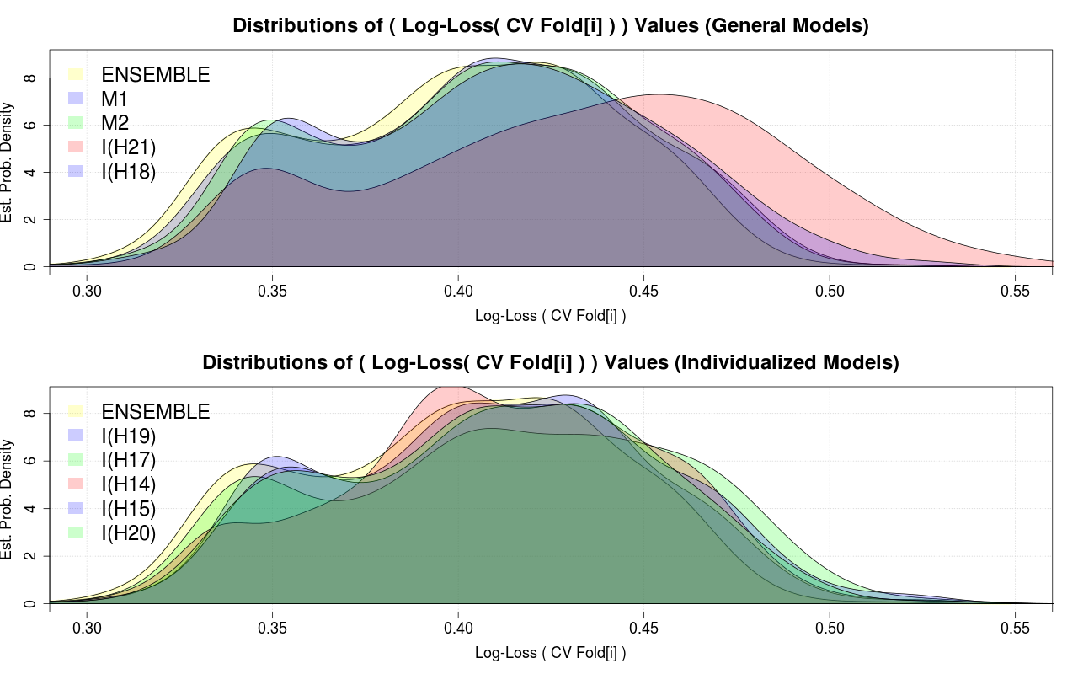
Exploration modeling applied to H[i] factors

Slide 29
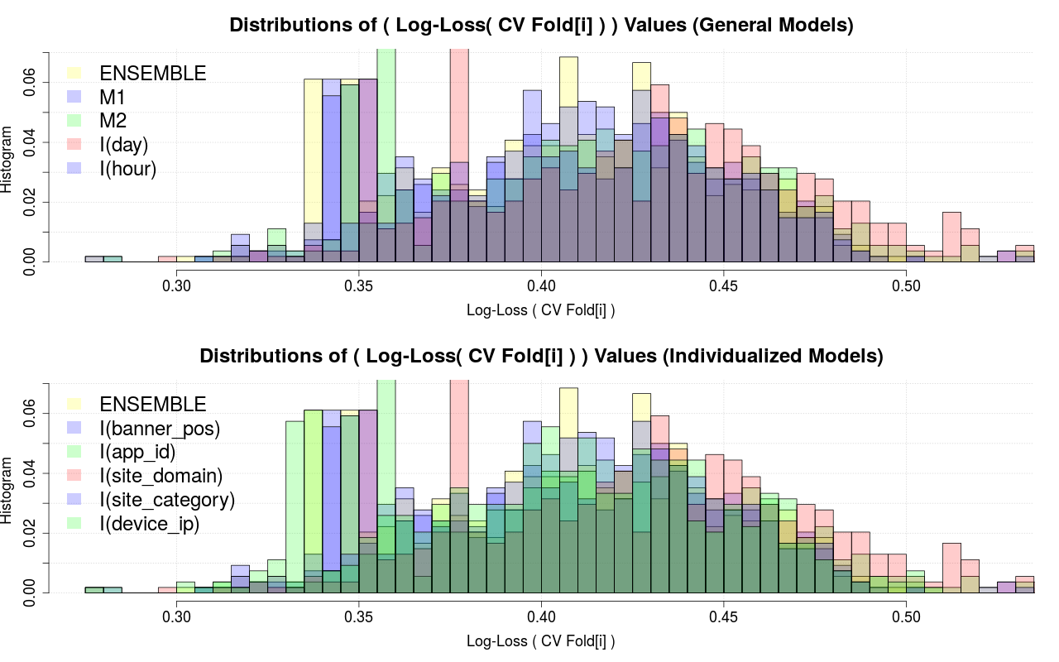
Misc. Slides: Histograms of Model's LogLoss (CVFold[i])

Slide 30
Miscellaneous Slides: Reference
Research Papers:
ClickThru: Yahoo, Google, Microsoft
Ensembles: Boosting, Bagging
Kaggle Avazu: https://www.kaggle.com/c/avazu-ctr-prediction
R code: http://bitbucket.org/nelsonmanohar/machinelearning/

